Slide 1

“Customer Churn Analysis using Power BI”
M. Rithvik
M. Rakesh

Slide 2
Agenda
Problem Statement
Objectives
Dataset Overview
Data Preprocessing
Customer Demographic Insights
Service Subscription Insights
Contract & Billing Insights
Recommendations
Conclusion

Slide 3
Problem Statement
Customer churn refers to the customers discontinuing a company’s services over time.
High churn directly affects revenue, profitability, and long-term business growth.
Acquiring new customers is significantly more expensive than retaining existing ones.
Customers churn due to multiple factors such as pricing, contracts, and service experience.
Objective
Analyze customer churn behavior by examining customer demographics, service usage, and billing information.
Identify the key factors and patterns that influence customers’ decisions to discontinue the service.
Segment customers into different groups to understand which segments are most likely to churn.
Generate actionable insights that can help businesses improve customer retention and reduce revenue loss.

Slide 4
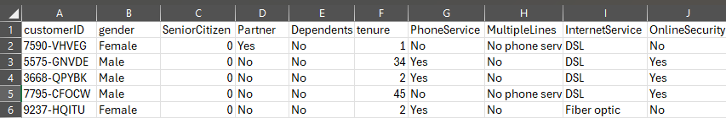
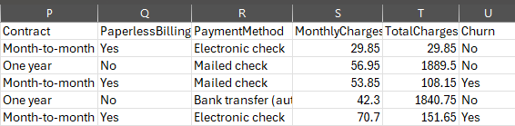
Dataset Overview
The analysis uses the Telco Customer Churn dataset containing customer-level information.
The dataset consists of 7,043 customer records with a churn indicator for each customer.
It includes demographic attributes such as gender, senior citizen status, and dependents.
Service-related details cover internet type, phone service, and additional subscriptions.
Contract and billing information includes contract type, payment method, and charges.

Slide 5
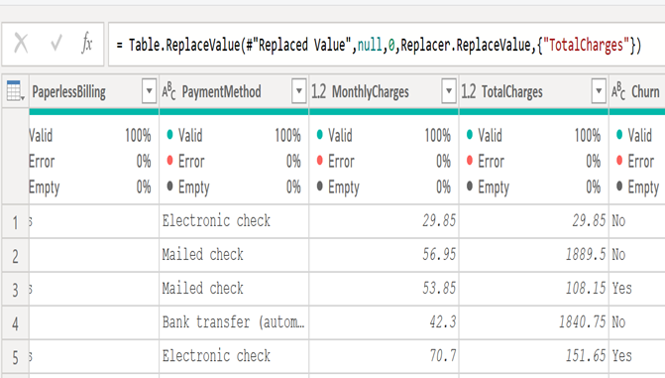
Data Preprocessing
The raw dataset was reviewed to identify missing values and data type inconsistencies.
The “Total Charges” field was converted from text to numeric for accurate calculations.
Customer tenure was grouped into meaningful ranges to analyze churn behavior over time.
Key metrics such as churn rate, average charges, and customer counts were created using DAX.
Categorical variables were standardized to ensure consistency across visuals and filters.
The prepared data was used to build analytical visuals that highlight the churn patterns.

Slide 6
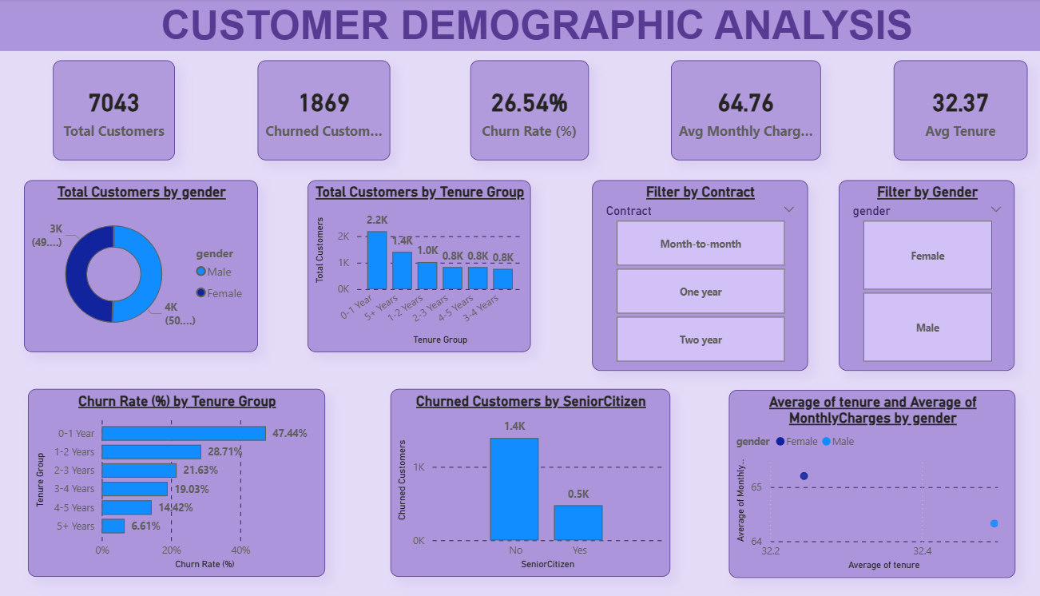

Slide 7
Customer Demographics Insights
The customer base is almost evenly split between male and female customers, showing no major gender imbalance.
Churn rates are nearly the same across genders, indicating that gender alone is not a strong churn driver.
Customers with very short tenure (0–1 year) show the highest churn rate, close to half of the customers in that group.
Churn steadily decreases as tenure increases, with long-term customers showing much stronger retention.
Senior citizens contribute a smaller portion of the customer base but exhibit a noticeably higher churn tendency.
Overall, customer tenure has a much stronger influence on churn behavior than gender differences.

Slide 8
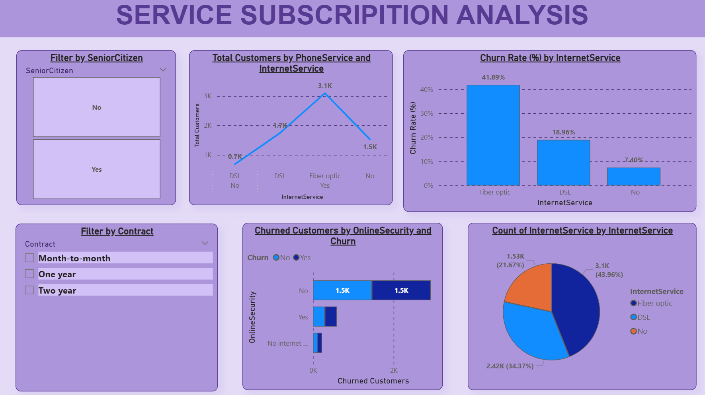

Slide 9
Service Subscription Insights
Customers using fiber optic internet exhibit a significantly higher churn rate compared to other internet types.
Customers with DSL internet show moderate churn, while customers without internet have the lowest churn rate.
Lack of online security is strongly associated with higher customer churn.
Customers who subscribe to additional services tend to show better retention behavior.
Service experience plays a critical role in influencing customer churn decisions.
Improving service quality and add-on adoption can help reduce churn rates.

Slide 10
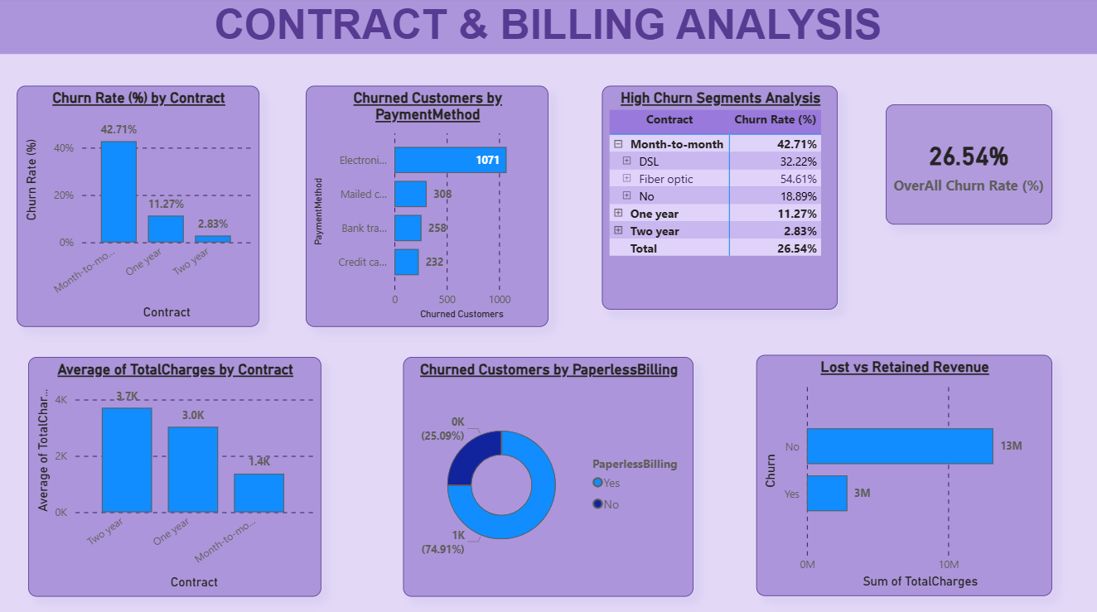

Slide 11
Contract & Billing Insights
Customers on month-to-month contracts exhibit the highest churn rate among all contract types.
One-year and two-year contract customers show significantly better retention behavior.
Longer contract durations are associated with increased customer stability and loyalty.
Customers using electronic check as a payment method have higher churn compared to other methods.
Paperless billing customers demonstrate a relatively higher churn tendency.
Contract structure and billing preferences strongly influence customer retention outcomes.

Slide 12
Recommendations
Encourage customers to move from month-to-month contracts to longer-term plans by offering discounts or bundled benefits.
Improve the service quality and reliability of fiber optic internet, as this segment shows the highest churn rate.
Promote online security and add-on services to customers who do not currently subscribe, as these customers churn more frequently.
Focus retention efforts on new and short-tenure customers through early engagement and personalized offers.
Introduce targeted support programs for high-risk customer segments, such as senior citizens and fiber optic users.
Review billing preferences and incentivize more stable payment methods to reduce churn linked to electronic check usage.

Slide 13
Conclusion
Customer churn in this dataset is driven primarily by tenure, contract type, and service usage patterns.
New customers and month-to-month contract users represent the highest churn risk across the customer base.
Fiber optic internet users and customers without online security exhibit significantly higher churn behavior.
Demographic factors such as gender have minimal impact, while tenure and age-related factors play a larger role.
Contract structure and billing preferences strongly influence customer retention and revenue stability.
Data-driven analysis using Power BI provides clear insights that can support effective churn reduction strategies.

Slide 14

THANK YOU

